Slide 1
Content
Algorithms testing
Random walk (classic)
Random walk (modified)
Cliff
Roadmap: where are we going?
Future lines (18/05/2017)
DANIEL GARCÍA-OCAÑA HERNÁNDEZ

Slide 2
Content
ALGORITHMS TESTING
Random walk (classic)
RANDOM WALK (MODIFIED)
CLIFF
Roadmap: where are we going?
Future lines (18/05/2017)

Slide 3

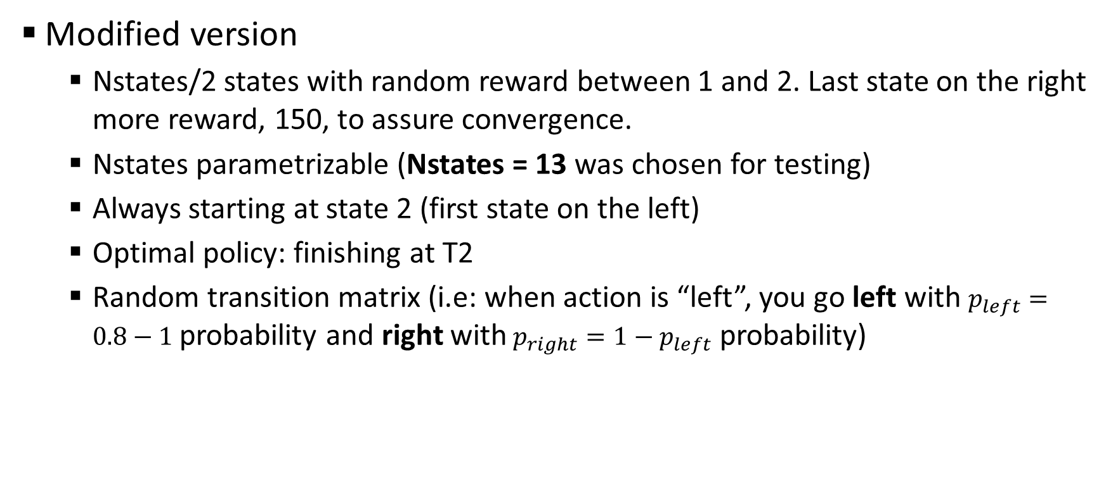
Random walk (modified)
Modified version
Nstates/2 states with random reward between 1 and 2. Last state on the right more reward, 150, to assure convergence.
Nstates parametrizable (Nstates = 13 was chosen for testing)
Always starting at state 2 (first state on the left)
Optimal policy: finishing at T2
Random transition matrix (i.e: when action is “left”, you go left with $p_{left}=0.8−1$ probability and right with$p_{right}=1−p_{left}$ probability)
T1
T2

Slide 4
Comparison
Comparison between DA TD (model-free), SARSA and Q-learning. All of them with optimal parameters.
¿Comparar también con model-based?

Slide 5
Comparison
Comparison between DA TD (model-free), SARSA and Q-learning. All of them with optimal parameters.
¿Comparar también con model-based?

Slide 7
Cliff

Slide 8
Content
Algorithms testing
Random walk (classic)
Random walk (modified)
Cliff
ROADMAP: WHERE ARE WE GOING?
Future lines (18/05/2017)

Slide 9
Roadmap: where are we going?
Algorithm… | Compare with… | Problems to test with…
Dual-Ascent (DA): Model based → exact solution (DP) Model free → stochastic gradient (RL) | SARSA Q-learning Double Q-learning | Random walk (classical) Random walk (modified) Cliff
DA with Linear Function Approximation (DA-LFA) | LSPI LSTD GTD2 Variance reduction | Chain walk (RL course version) Mountain car
DA with Non-Linear Function Approximation (DA-NLFA) | Deep Q-learning (DQN) Neural fitted Q-iteration (NFQ) | Mountain Car Cart-Pole Videogames
¡¡CONTINUOUS STATE SPACE!!
Neural networks
Python
OpenAI

Slide 10
Content
Algorithms testing
Random walk (classic)
Random walk (modified)
Cliff
Roadmap: where are we going?
FUTURE LINES (18/05/2017)

Slide 11
Future lines (18/05/2017)
Complete simulations

